Slide 1
Linked list

Slide 3
Basics
Structures
‘ . ’ operator
-> operator
Arrow operator replaces dot operator, if pointer is used to access members of a struct or class

Slide 4
Link List
Linear data structure
Better than the array in some aspects
Memory efficient than the array

Slide 5
Linked List Building blocks

Slide 6
Traversing a Link List

Slide 7


Inserting a Node in the middle
Assume, we want to insert a value of 50 between 65 and 34

Slide 8
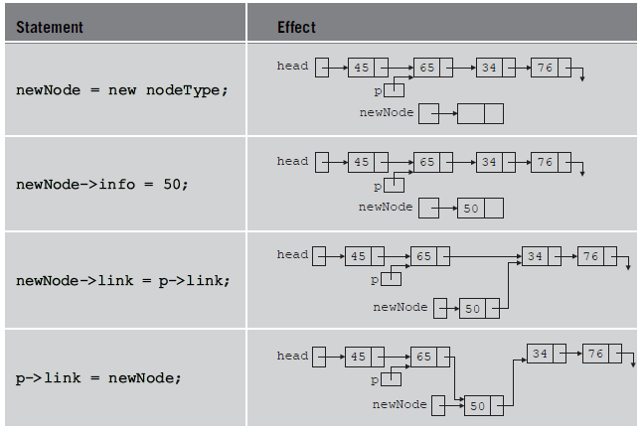

Slide 9
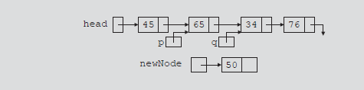
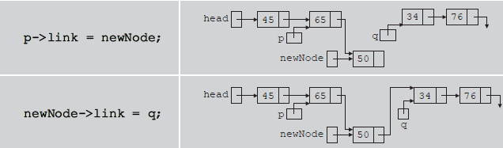
Another approach for insertion

Slide 10
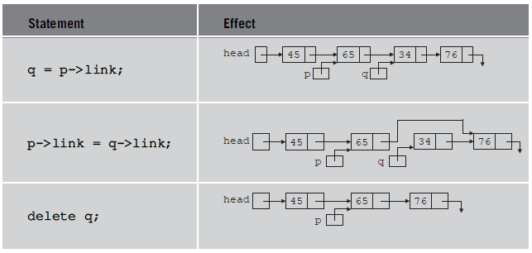
Deleting a Node
Assume, we want to delete a node with value of 34

Slide 11
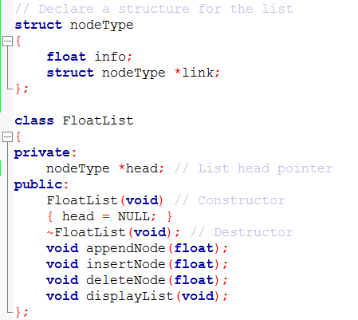
Link List class

Slide 12
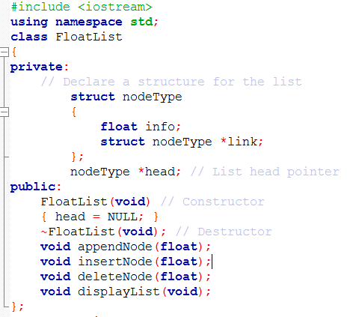
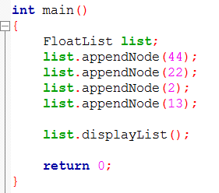
Link List class for storing float values

Slide 13
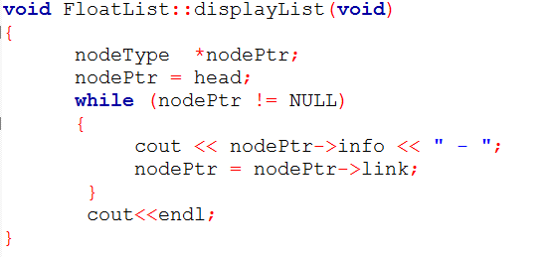

Slide 14
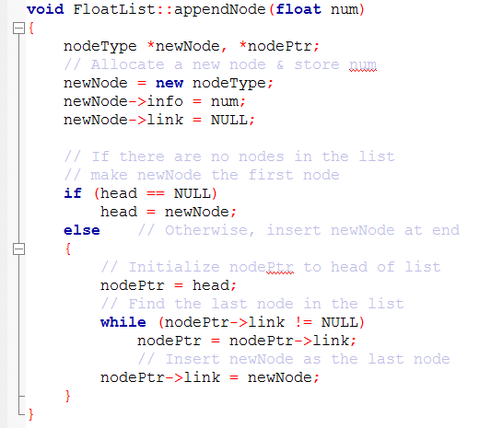

Slide 15
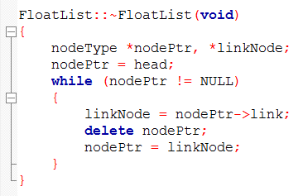
Destructor

Slide 16
